Slide 1
Mantid Scientific Steering Committee
Nick Draper
11/05/2011

Slide 2
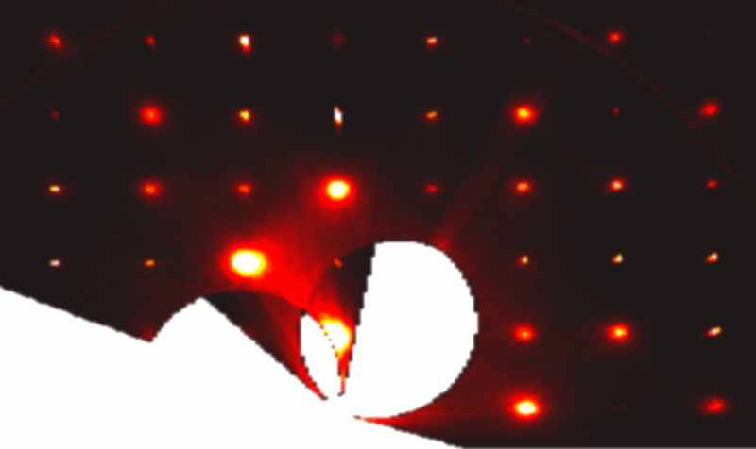
This Release
Target Date
  21st April 2012
Significant release
  2 ½ months development
  530 tickets (808 previous)
Actual Release Date
  4th May 2012
  Dropped back by to fit better with dev team training and leave

Slide 3


This Release
Targets
Initial implementations for (some or all of):
  Indirect Support – VISION, BASIS
  Reflectometry – data splicing
  Live event viewing & processing
  Automated Reduction
  Data Chunking and distributed processing
  Python Algorithm support for New API
  Quantification for VATES
  Combine the Mantid & Vates installers

Slide 4
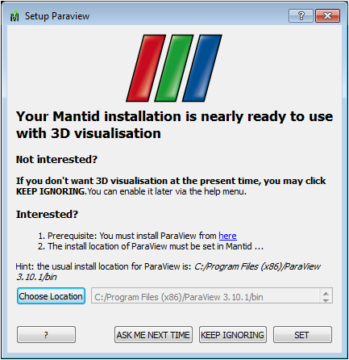
Progress over the last iteration
Installation
  Combined MANTID & VATES installer
    Combined our installer technologies
    Have to remove previous versions first
    Additional setup set for Paraview
  Vates not supported on Mac
    Coming soon

Slide 5
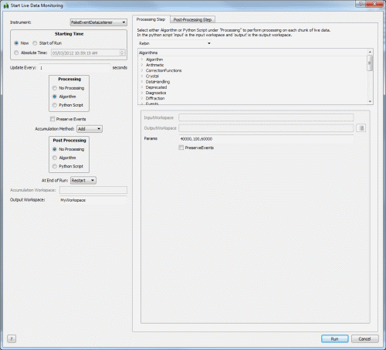
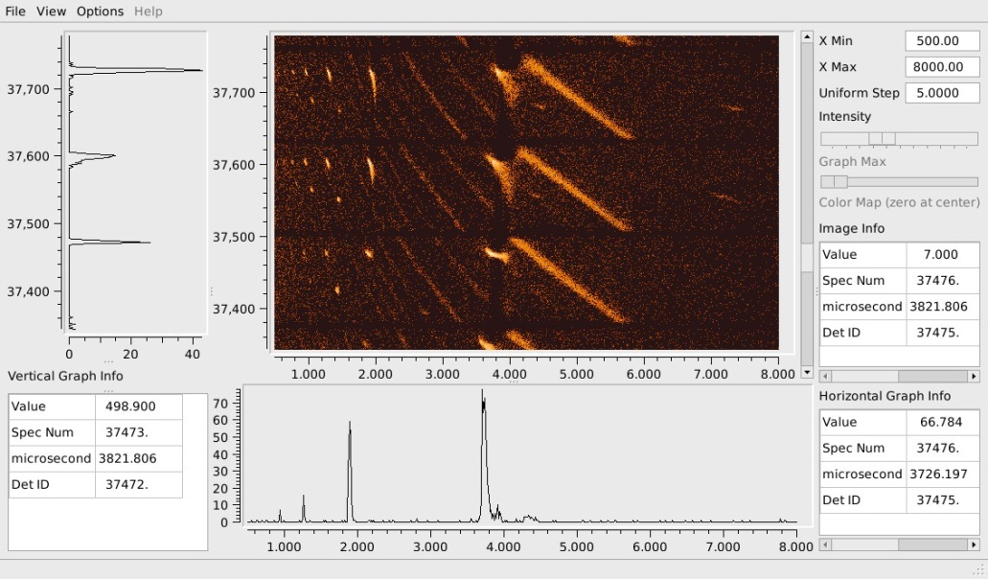
Progress over the last iteration
UI Changes
Live Data Processing
  simple to complex data processing
  Graphs update dynamically.
  DAE/DAS broadcast mechanisms are not yet in place.
  FakeEventListener & FileEventListener
Prototype Image Viewer
  Event workspaces only
Loading .py files
Removing items from the interfaces menu

Slide 6
Progress over the last iteration
Framework
  Calibration of detectors
  Automated data reduction
    Install without the graphical user interface
    In use on POWGEN, NOMAD, SEQUOIA and BASIS
  Archive Search for the SNS
  Improved threading for Event Workspaces
  SofQW & Rebin 2D
    Normalisation for fractional area
    Accounts for non observable or masked areas
  Mask Workspaces
    Use and funcationality has been significantly increased in this release.
    Several new algorithms to work with mask workspaces

Slide 7
Progress over the last iteration
Framework
  Algorithm name changes
    See release notes
  Multiple file loading and summing
    All load algs perform multiple loading and summing
      MAR17198 + 17199 + 17240 sum the three files
      MAR17198, 17199, 17240 load the three files separately
      MAR17198-17240 sum all of the files between 17198 and 17240 inclusively
      MAR17198:17240 load all of the files between 17198 and 17240 inclusively as separate workspaces
      MAR17198-17240:2 sum all of the files between 17198 and 17240 inclusively, with a step of 2

Slide 8
Progress over the last iteration
Framework
  Model Optimisation
    Restructured to allow efficient operations on very large datasets
    Several new fit functions
      flat background, stretched exponential and several muon specific functions.
  Instrument definitions
    Overlapping validity date ranges, if two files are valid the latest is selected.
  Mantid projects
    Waterfall plots and curve fit functions are now included in the saving/loading of MantidPlot projects

Slide 9
Progress over the last iteration
Python Scripting
  Multiple Script Execution
  Previous versions of Mantid:
    only a single Python script could be executed at a time
    long running code would cause the GUI to hang
  This version:
    Multiple Python scripts simultaneously
    running long bits of code will no longer hang the GUI
    each script now has its own output window rather each script sharing a single window
    script cannot be edited while it is being executed

Slide 10
Progress over the last iteration
Python Scripting
  Helping migration from v1 to v2 (first cut)
    First release of migration script (migrate1to2.py):
      the simpler cases of direct string replacements, e.g. from mantidsimple import * from mantid.simpleapi import *
      algorithm calls that do not capture a return value, e.g. Load('runfile.ext','runWS') testWS = Load(Filename='runfile.ext')
      More details can be found in the changes document.
  Python algorithms exposed to new API
    A tutorial for creating a Python algorithm with the new API can be found here: Python Algorithms Documentation

Slide 11
Progress over the last iteration
Direct Inelastic
  General
    GenerateGroupingSNSInelastic
      generates grouping/mapping files for SNS direct geometry instruments.
  SofQW3
    New algorithm added that correctly tracks the fractional areas in the overlapping polygon rebinning.
    For areas with no data, they are now treated correctly as NaNs.

Slide 12
Progress over the last iteration
Indirect Inelastic
  General
    Initial support for the VISION instrument at the SNS.
    New Python Algorithms for road-testing: (Win32 only)
      ForCE, Jump, Qlines, Quest, ResNorm
  Convert to Energy
    BASIS
      reduction tested and validated by instrument scientists.
      reduction time improved by an order of magnitude.
  Indirect Data Analysis
    Removal of Absorption tab.
  Indirect Diffraction
    Updated and fuller support for OSIRIS has been added, with more robust input parsing..

Slide 13
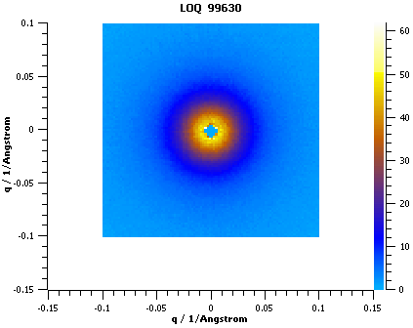
SANS
SANS
  ISIS
    http://www.mantidproject.org/ReleaseNotes_2_1_ISIS_SANS
  ORNL
    http://www.mantidproject.org/ReleaseNotes_2_1_ORNL_SANS

Slide 14
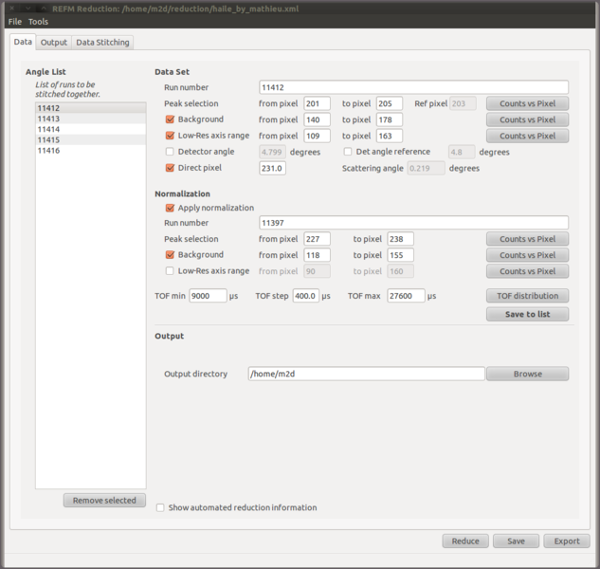
Progress over the last iteration
Muon
  http://www.mantidproject.org/Release_Notes_2_1_MuonAnalysis
Diffraction
  http://www.mantidproject.org/ReleaseNotes_2_1_SingleCrystalDiffraction
Reflectometry
  http://www.mantidproject.org/ReleaseNotes_2_1_Reflectometry

Slide 15
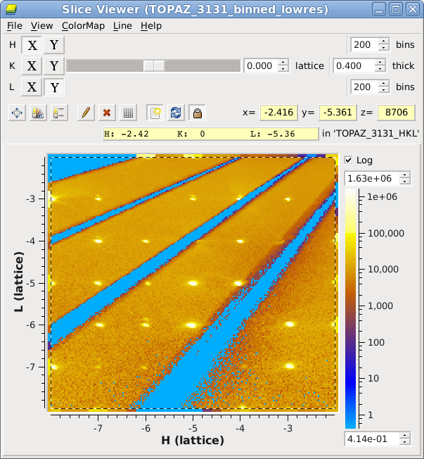
Progress over the last iteration
VATES
  http://www.mantidproject.org/Release_Notes_2_1_Vates

Slide 16
Next Release
Target Date
  6th July 2012
Initial implementations for:
  Quantification for VATES
  Vates on the Mac
Science led development
  Discussion

